Slide 1
Why
should we practice
‘Reproducible research’?

Slide 2

Data Sharing and Management Snafu in 3 Short Acts

Slide 3
Scientific Integrity:
Rigor, trustworthiness, and transparency;
Allows others to verify analyses, find and correct mistakes
Community Good:
Others can learn from your approach and methods
Efficient Research:
Helps you remember HOW and WHY you did something.
Speed up this project:
Automation makes it faster and easier to redo analyses. The time you save can be spent doing more important stuff.
Speed up future projects:
You can use the scripts from one project for another one.

Slide 4





data
acquisition
data
processing
data
analysis
data
presentation
Documentation

Slide 5
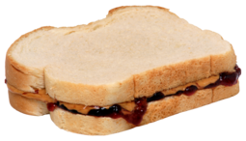
acquisition
processing
analysis

Slide 6
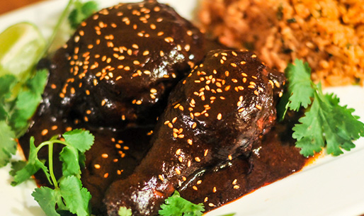
Note: To make a milder version, omit the puya chilies. The chilies, Mexican chocolate and crema (a type of sour cream) are available in Mexican and Latin markets.
1. The day before making the mole, remove the stems and seeds from the chilies; rinse the chilies and pat dry. Reserve ¾ teaspoon of the seeds and set aside. Heat ½ cup oil in a large skillet, add the chilies (in batches if necessary) and fry until glossy, about four minutes. Drain and place in a Dutch oven. Cover with 10 cups hot water, add the vinegar and let stand overnight.
2. The next day (or several hours later), drain the chilies and reserve the soaking liquid. Working in batches, place the drained chilies in a blender. Add enough soaking liquid to blend them smoothly. Repeat with the remaining chilies and set the mixture aside. This makes about eight cups.
3. Cut the tomatoes in half lengthwise. Do not peel them before or after roasting. Slice ½ small onion crosswise into 1-inch-thick pieces. Roast the tomatoes, sliced onion and 2 cloves of garlic in an ungreased skillet over medium-high heat until spotted with brown. Set aside.
4. Add the coriander seeds, anise seeds, pepitas, reserved chile seeds, peppercorns, cloves, ¼ cup plus 2 tablespoons of the sesame seeds and cinnamon stick to the skillet and roast just until fragrant, about one minute. Transfer to another bowl.
5. Add ½ cup oil to the skillet. When the oil is hot, fry the tortilla, then the bolillo slices, until the tortilla is crisp and the bolillo slices are golden. Remove and drain on a paper towel. Fry the plantain slices until golden and softened. Remove with a slotted spoon. Set aside.
6. Fry the peanuts, almonds and raisins for about one minute until almonds and peanuts are well-browned. Drain on a paper towel. Fry the seeds and spices toasted in step four for 30 seconds. Strain them through a sieve, discarding the oil.
7. Heat the remaining ½ cup oil in a Dutch oven. Add the puréed chile mixture and enough of the reserved soaking liquid to keep the puréed mixture from erupting like a volcano when it simmers. Simmer for 10 to 15 minutes, stirring often.
8. Add the fried cinnamon stick to the puréed chile mixture. In a blender, combine the rest of the spices, seeds, nuts and raisins. Grind with enough chile soaking liquid to purée. Add to the chile mixture.
9. Grind the reserved roasted tomatoes, onions and garlic cloves, the thyme leaves and the parsley sprig in the blender with enough chile soaking liquid to purée, then add to the Dutch oven.
10. Crumble the fried tortilla into small pieces. Place the bolillo slices, tortilla pieces and plantain slices in the blender with 1 tablespoon of the salt. Add enough soaking liquid to blend. Add this to the Dutch oven. Add the chopped chocolate and stir until dissolved. Add sugar to taste.
11. Stir constantly over medium heat until the sauce thickens to the desired consistency and becomes very dark. Strain the sauce through a fine sieve, in batches if necessary, and return to a clean pot. Failure to strain the sauce will result in an unpleasant texture filled with flecks of chile skin. Place the sauce over low heat. Discard remaining chile soaking liquid. Makes 10 cups of sauce.
12. Wash the chicken pieces and place them in a large Dutch oven or stockpot. Add water to cover. Add the medium onion quarters, bay leaves, remaining 4 garlic cloves and remaining tablespoon salt. Bring to a boil, then turn down the heat and simmer for 20 minutes. Remove the chicken from the pot. Strain the stock and set aside.
13. Place the chicken pieces into the pot with the mole sauce or, if there is not room, put the chicken in a large pot and pour in the sauce. Bring the sauce to a simmer and continue to cook until cooked through, an additional 15 to 20 minutes, adding stock as needed to thin the sauce. Reserve remaining stock for another use.
14. To serve, place a serving of chicken on each plate and cover generously with mole sauce. Sprinkle with the remaining 2 tablespoons of sesame seeds. Drizzle crema on the chicken and around the plate. Serve with Mexican or white rice. Freeze leftover mole in an airtight container.
MOLE POBLANO Makes 12 servings
16 dried mulato chilies
20 dried pasilla negro chilies
10 dried ancho chilies
14 dried chipotle chilies
4 dried puya chilies, optional, see note
1½ cups corn oil, divided
1 teaspoon white vinegar
2 large plum tomatoes
½ small onion
6 cloves garlic, peeled, divided
¼ teaspoon coriander seeds
¼ teaspoon anise seeds
2 tablespoons pepitas (pumpkin seeds)
¾ teaspoon black peppercorns
2 whole cloves
½ cup sesame seeds, toasted, divided
1 stick cinnamon
1 corn tortilla
¼ bolillo roll, sliced crosswise in 4 slices
¼ ripe plantain, sliced
¼ cup shelled raw peanuts
1/3 cup plus 1 tablespoon blanched almonds
1/3 cup raisins
Leaves from 1 sprig thyme
1 sprig Italian parsley
2 tablespoons salt, divided
2 tablets Mexican chocolate, or 6 ounces dark chocolate, chopped
½ to 1 cup sugar, according to taste
2 whole chickens, cut into serving pieces, or 6 pounds chicken parts
1 medium onion, peeled and cut into quarters
4 bay leaves
¾ cup Mexican crema for garnish
Recipe adapted from one by Jaime Martin del Campo and Ramiro Arvizu in the Los Angeles Times

Slide 7
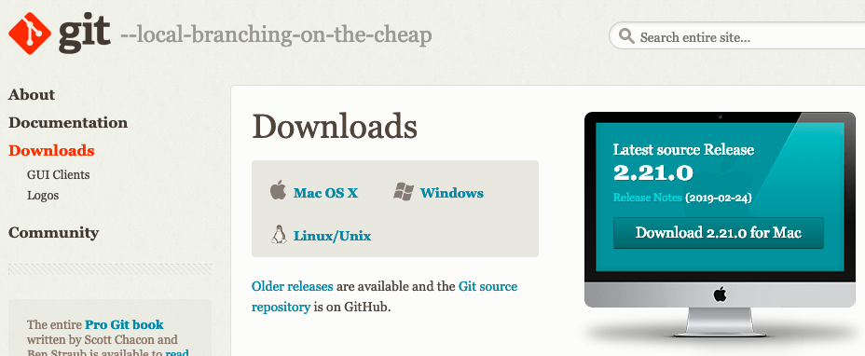
While waiting for class, go to
https://git-scm.com/downloads
& download the version of GIT for your computer’s operating system.
If you have time, install it using the instructions here:
https://datacarpentry.org/semester-biology/computer-setup/

Slide 8
What is
‘Version Control’?

Slide 10
2013-10-14_manuscriptFish.doc
2013-10-30_manuscriptFish.doc
2013-11-05_manusctiptFish_intitialRyanEdits.doc
2013-11-10_manuscriptFish.doc
2013-11-11_manuscriptFish.doc
2013-11-15_manuscriptFish.doc
2013-11-30_manuscriptFish.doc
2013-12-01_manuscriptFish.doc
2013-12-02_manuscriptFish_PNASsubmitted.doc
2014-01-03_manuscriptFish_PLOSsubmitted.doc
2014-02-15_manuscriptFish_PLOSrevision.doc
2014-03-14_manuscriptFish_PLOSpublished.doc

Slide 11
Alternative:
Version Control Software

Slide 12
Software that keeps track of changes to your files for you:
Keeps the entire history of a file & allows you to inspect a file throughout its lifetime
You can tag a particular version so you can go back to it easily
Facilitates collaborations, allows people to help you, makes contributions transparent
Allows you to experiment (with code) without fear
Backup of your project
No need for a server, easy to set up
FREE

Slide 13
YOU
SAVE
SAVE
SAVE
SAVE
YOUR
COLLABORATOR

Slide 14
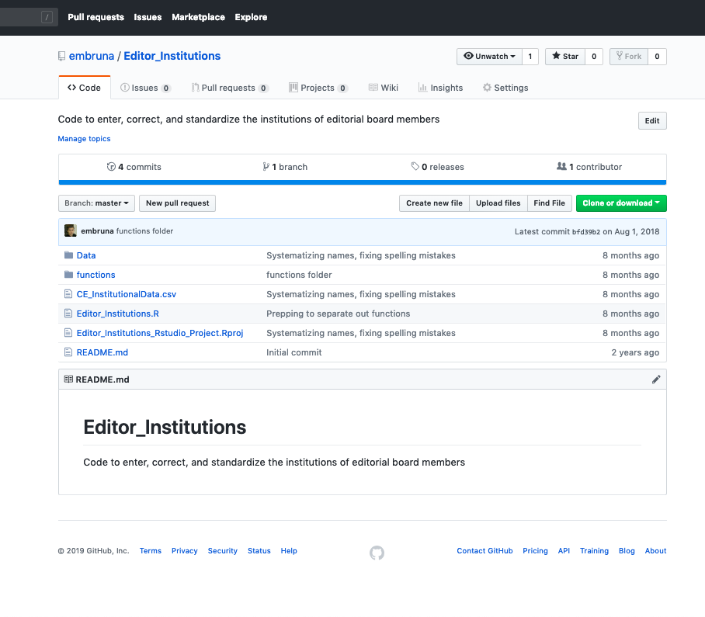

Slide 15
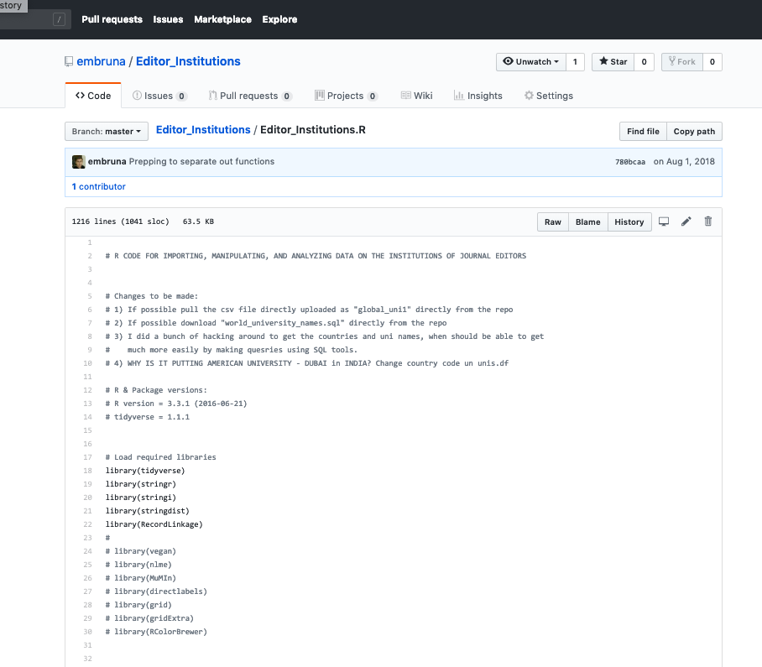

Slide 16
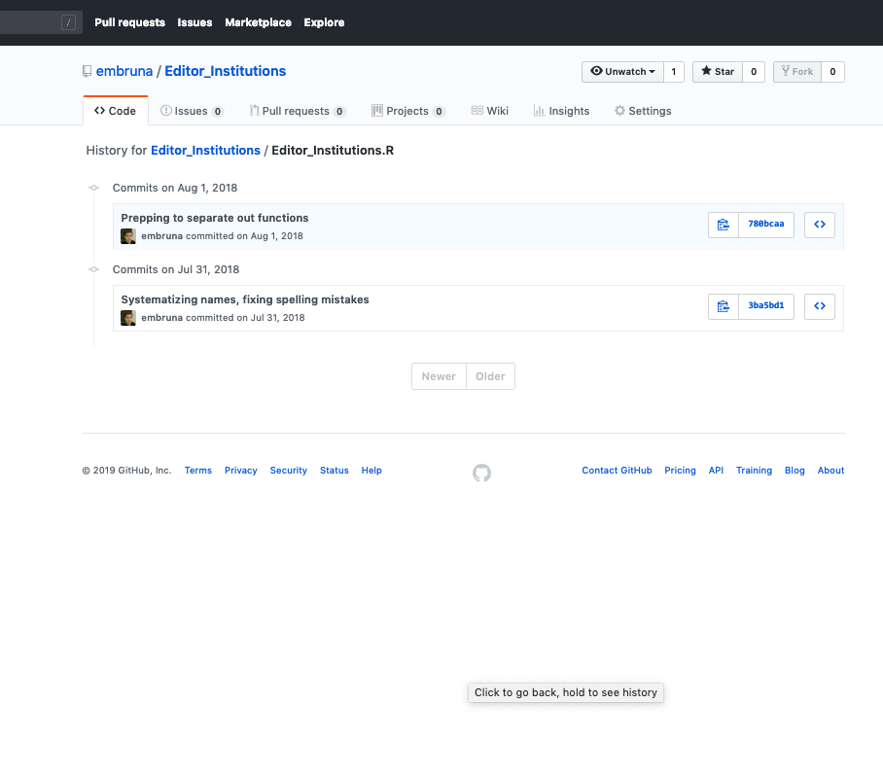

Slide 17
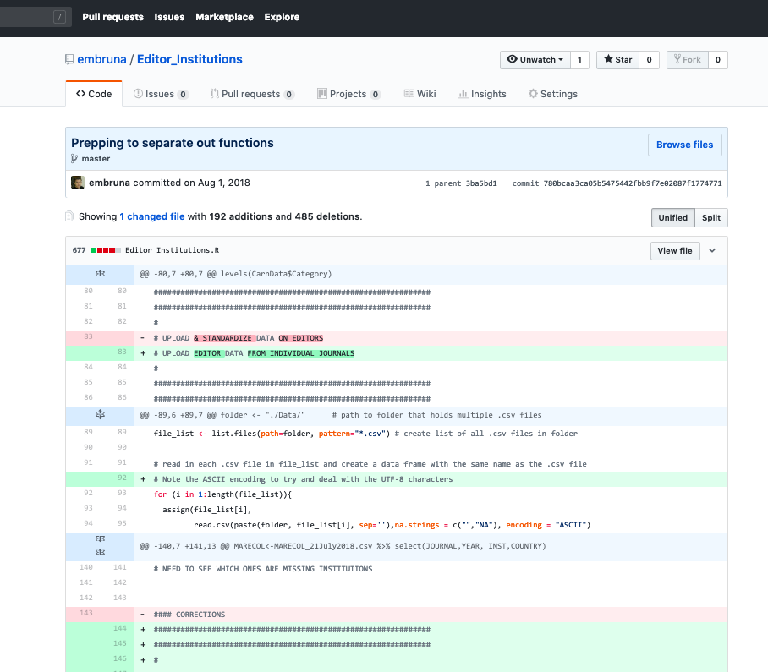

Slide 18
While waiting for class, go to
https://git-scm.com/downloads
& download the version of GIT for your computer’s operating system.
If you have time, install it using the instructions here:
https://datacarpentry.org/semester-biology/computer-setup/

Slide 19
Let’s see how it works.

Slide 20
Set up a PRIVATE repository for your data project
Invite me to be a “collaborator” (so I can grade it & offer suggestions)
Make a change to your R script.
Push the commit
Confirm that the change is online

Slide 21
OK, that was version control…

Slide 22
Using the gapminder Dataset Visualize life expectancy over time for Canada in the 1950s and 1960s using a line plot. Stretch goal: Add lines for Mexico and US.
Swap instructions/documentation with your partner, and try to reproduce their work without talking to each other.
Then, talk to each other about challenges you faced (or didn't face) or why you were or weren't able to reproduce their work.

Slide 23
What tools did you use (Excel / R / Word / plain text etc.)?
Was your collaborator successful in reproducing your work?
Have you ever tried to reproduce someone else's data analysis before?Have you ever tried to reproduce your own work before?
What tools did you use and were you successful in reproducing your collaborator's work?
What made it easy/hard for reproducing your parners' work?
What would have to happen if you had to extend the analysis further?
If you caught a data error how easy/hard would it be to re-create the analysis?
What would happen if your collaborator is no longer available to walk you through their analysis?

